Slide 1
Growth Mindset & The Study Cycle

Slide 2
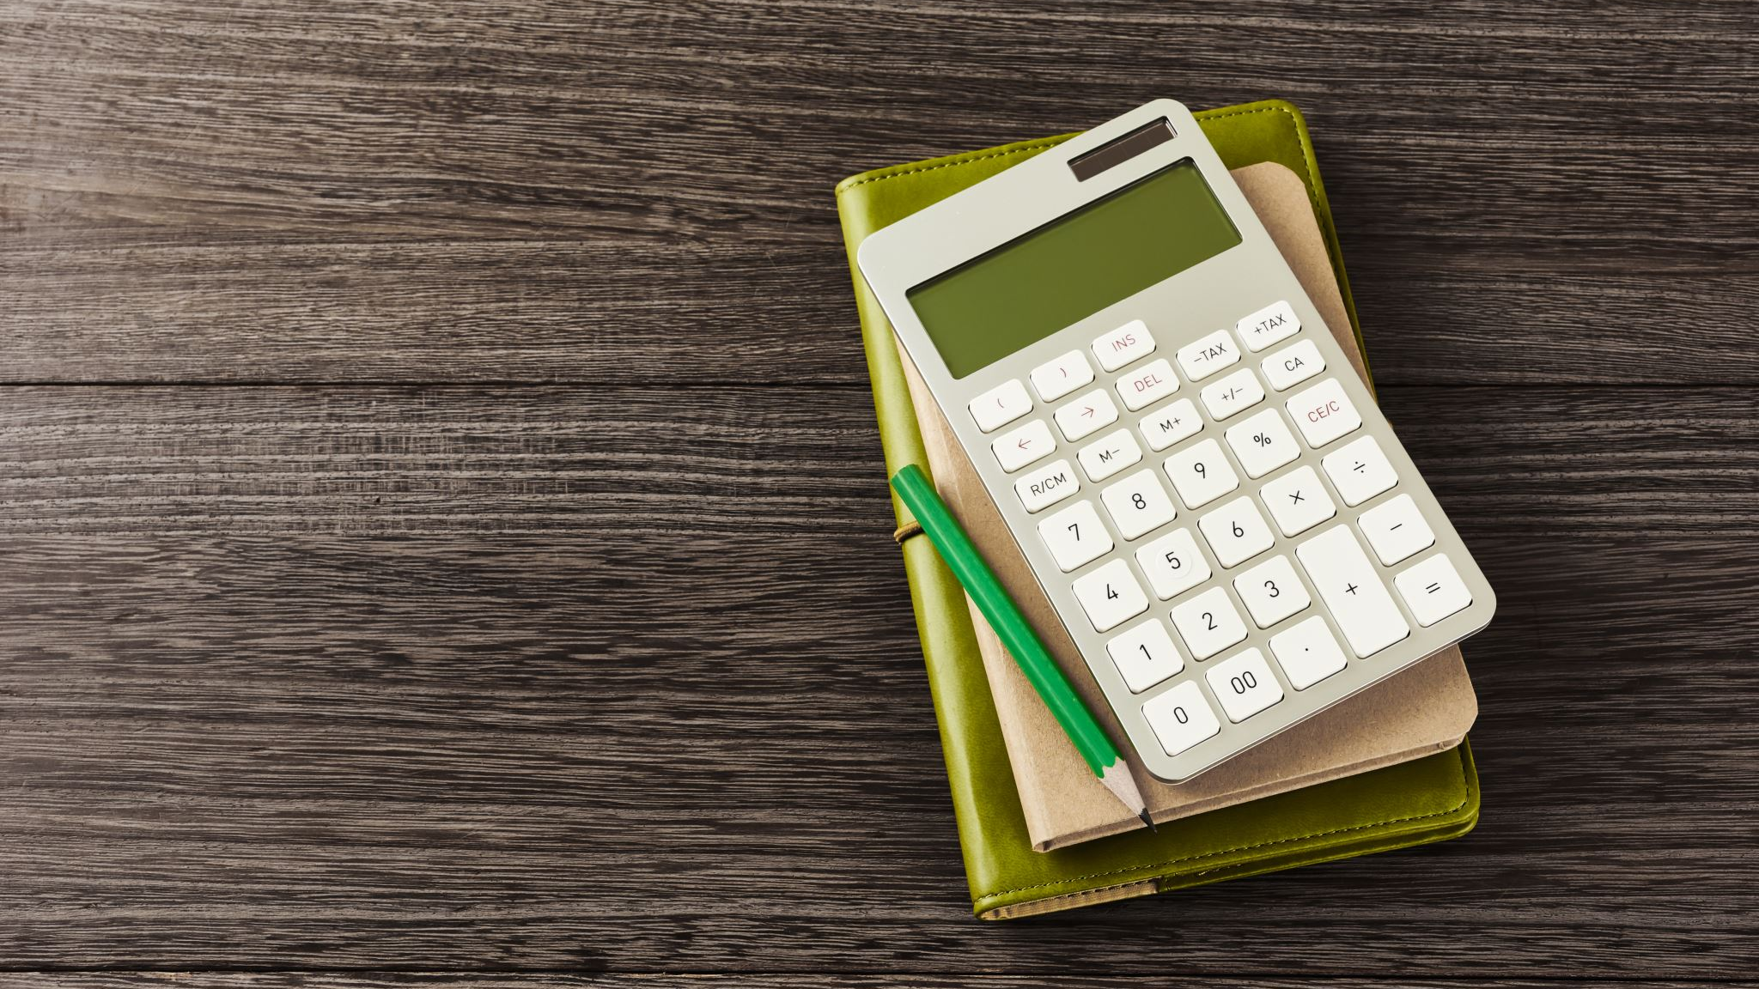
Group Roles:
Time
Notes
Equality
Questions
Report

Slide 3
Breakout Rooms
What is the difference between studying and learning? Where does studying/learning occur? Which is harder?
What did you vs. your teacher do before tests in high school? How did you prepare? How did the teacher prepare you?
How do grades impact your learning as a student? What are the benefit of grades? What are the challenges?
What are the benefits of working with your peers to study? What are the challenges?

Slide 4
What is the difference between studying and learning?

Slide 5
In high school, what did most of your teachers do the day before a test?
How well did you do on those tests? Which were hardest?
What did you do during class on the day before the test?
What grade would you get on the test if you only attended the day before the test?

Slide 6
Benefits and Challenges of Grades

Slide 7
Peer Studying: Benefits & Challenges

Slide 8
“studying is short term; learning is long term.”
“studying is memorizing information; learning is when I can apply it.”
“studying is focusing on the ‘whats’ and learning is focusing on the ‘hows,’ ‘whys,’ and ‘what ifs.’”
“studying is what I do the night before the exam.”

Slide 9
Up until this point, have you been in study mode, or learning mode?

Slide 10
Metacognition = Expert Learner
The ability to think about thinking
Being consciously aware of yourself as someone who has a problem to solve
Monitoring and controlling your own mental processing
Being aware of the type of learning you’re expected to do

Slide 11
POLL TIME

Slide 12
For which task would you work harder?
To make an A on the test
To teach the material to the class

Slide 13
Up until this point, have you been in “make an A” mode, or “teach the material” mode?

Slide 14
The power of peer teaching
We find out what we don’t know as well as we imagined
Anticipating questions
Multiple perspectives
Different levels of learning

Slide 15
Blooms Taxonomy

Slide 17
Goldilocks and Bloom’s Levels
REMEMBER: What three items in the bears’ house did Goldilocks interact with?
UNDERSTAND: Paraphrase the story of Goldilocks (to a specific audience)
APPLY: The bears’ items corresponded to which 3 parts of the house?
ANALYZE: Why did Goldilocks enter a bear’s cottage in the first place?
EVALUATE: Which of the following scenarios is Goldilocks more likely to prefer?
CREATE: Design a Goldilocks story for the 21st century.

Slide 18
How can Bloom’s Taxonomy help you as a student?

Slide 19
Counting vowels in 45 seconds
Count all the vowels in the words on the next slide
AEIOU (no Y)

Slide 20
Dollar Bill
Dice
Tricycle
Four-leaf Clover
Hand
Six-Pack
Seven-up
Octopus
Cat Lives
Bowling Pins
Football Team
Dozen Eggs
Unlucky Friday
Valentine’s Day
Quarter Hour

Slide 21
How many words or phrases do you remember?

Slide 22
Let’s look at the words again… How are they arranged? Is there a pattern?

Slide 23
Dollar Bill
Dice
Tricycle
Four-leaf Clover
Hand
Six-Pack
Seven-up
Octopus
Cat Lives
Bowling Pins
Football Team
Dozen Eggs
Unlucky Friday
Valentine’s Day
Quarter Hour

Slide 24
Now, how many words and phrases do you remember?

Slide 25
What are the differences between the first and second attempts?
We knew what the task was
We knew how the information was organized

Slide 26
Turning yourself into an efficient learner
Do
Do “think aloud” exercises
Ask
Constantly ask “why” and “what if” questions about the material
Test
Test your understanding by verbalizing or writing about concepts
Practice
Practice retrieval of information
Rise
Move your activities higher on the Bloom’s scale
Check
Check your assignments for Bloom’s keywords

Slide 28
Operating at different levels
Use the study cycle:
Preview
Attend
Review
Study
Assess

Slide 30
How to use metacognition effectively
Solve
Solve problems without looking at the example first
Memorize
Memorize basic information so you don’t have to look it up
Ask
Ask how, why, and what if questions
Review
Spend time reviewing each day (even 5-8 minutes while driving/walking)

Slide 31
Which of the following more accurately describes your actions to date in the course?
Didn’t spend enough time
Started late
Didn’t memorize information
Didn’t refer to assignment sheets and class materials
Assumed you should know the answer already
Preview-reviewed every class
Did small parts of the homework over time
Referred to materials and practiced concepts
Quizzed self on memory
Practiced explaining the information to others

Slide 32
The Statistics:
Students who do not use metacognitive and study strategies average 30% lower scores on assignments and tests
Students who start metacognition during a semester can generally increase their scores by 15%

Slide 33
What can you do now?
If you don’t start it within the next 48 hours, you probably never will

Slide 34
To do this week:
WEEK 1 REMAINDER:
Submit initial discussion post (due tonight)
Reply to peers before Sunday
Quiz on Leamnson article
WEEK 2:
Preview content
Check-in Quiz Monday

